Slide 1
Healthy Eating Dataset
​

Slide 2


Agenda
A
Introduction
Primary goals
Areas of growth
Timeline
Summary
Healthy Eating Dataset

Slide 3
Introduction
The Healthy Eating Dataset is a comprehensive collection of meal data designed to analyse nutritional patterns, diet types, and health indicators across various cuisines.
It includes attributes such as calories, protein, carbohydrates, fat, sodium, cholesterol, cooking methods, preparation time, and ratings.
The project leverages Excel, SQL, Power Query, Power BI, and Python to clean, analyze, visualize, and interpret the dataset, transforming raw information into actionable insights about healthy eating habits.
Healthy Eating Dataset

Slide 4



Meet our team
Gowathaman M A
Haresh Kumar R S​
Veerarakesh E
Healthy Eating Dataset

Slide 5

Primary goals
1) 📊 Data Cleaning & Preparation:
Use Excel and Power Query to remove duplicates, standardize data (e.g., consistent diet type names), and calculate derived metrics such as Total Time and Calorie Density.
2) 🧮 Data Storage & Querying:
Store the dataset in SQL and use queries to extract nutritional insights (e.g., top cuisines by average calories, high-protein meals).
Healthy Eating Dataset

Slide 6
3) 🐍 Exploratory Data Analysis (EDA):
Utilize Python (Pandas, Matplotlib, Seaborn) to conduct statistical analysis, visualize distributions, and identify correlations between nutrients and health outcomes.
5) 💡 Decision Support:
Enable users to identify balanced meals and make data-driven dietary choices.
4) 📈 Interactive Visualization & Reporting:
Build Power BI dashboards that display:
Healthy vs Unhealthy meal ratio
Cuisine vs Average Calories
Protein vs Calories
Calorie distribution
Average rating by diet type
Healthy Eating Dataset

Slide 7
Areas of Growth
🤖 Machine Learning Integration (Python): Predict whether a meal is healthy based on its nutritional profile.
🧾 Automated Data Refresh (Power Query): Connect to live or external nutrition data sources for real-time updates.
🌍 Data Expansion (SQL): Add more cuisines, regional diets, and new nutritional factors for broader analysis.
🎯 Performance Optimization (Power BI): Use DAX measures to improve report efficiency and add KPIs like Healthy %, Avg Calories, Avg Rating.
📚 Advanced Data Modeling: Integrate user feedback, meal costs, or ingredients to enhance the dataset’s depth.
Healthy Eating Dataset

Slide 8
Timeline
Phase | Task Description | Tools Used | Duration
Phase 1: Data Cleaning & Preparation | Remove duplicates, fix text inconsistencies, calculate new fields (Total Time, Calorie Density) | Excel, Power Query | 1 week
Phase 2: Database Setup & Querying | Load data into SQL, perform queries for insights | SQL | 1 week
Phase 3: Exploratory Data Analysis | Perform descriptive stats, correlation analysis, and visualizations | Python | 1 weeks
Phase 4: Dashboard & Reporting | Build Power BI visuals, KPIs, and publish final dashboard | Power BI | 1–2 weeks
Phase 5: Review & Documentation | Summarize insights, recommendations, and future improvements | All Tools | 1 week
Healthy Eating Dataset

Slide 9
Areas of focus
1) Data Storage and Management (SQL)
Import cleaned data into an SQL database for structured querying.
Design efficient table schemas for easy joins and indexing.
Run analytical SQL queries to explore trends:
  Top cuisines by average calories.
  Meals with above-average protein.
  Rating comparison between healthy vs unhealthy meals.
Use SQL views for connecting directly with Power BI dashboards.
2) Data Quality and Cleaning (Excel & Power Query)
Identify and remove duplicate meal records using Excel filters or Power Query.
Standardize text fields (e.g., cuisine names, diet types).
Handle missing or incorrect nutritional values.
Create derived columns such as:
  Total Time (min) = Prep Time + Cook Time
  Calorie Density = Calories / Serving Size
Ensure data consistency before importing into SQL or Power BI.
Healthy Eating Dataset

Slide 10
4) Exploratory Data Analysis (Python)
Use Pandas for data manipulation and summary statistics.
Visualize key metrics using Matplotlib and Seaborn:
  Calorie distribution histograms.
  Correlation heatmap between nutrients.
  Scatter plot of Protein vs Calories colored by Health Status.
Detect outliers or anomalies that might affect data accuracy.
Derive insights on the relationship between nutrition and ratings.
3) Visualization and Reporting (Power BI)
Build interactive dashboards showing:
  ✅ Healthy vs Unhealthy meal counts.
  🍽️ Cuisine vs Average Calories.
  ⭐ Average Rating by Diet Type.
  🧮 Calories, Protein, and Fat composition by meal type.
Use DAX Measures such as:
  Total Meals
  Healthy Meals
  Healthy %
  Avg Calories
  Avg Rating
Apply slicers and filters for cuisine, diet type, and health status.
5) Insight Generation & Decision Support
Identify nutritional patterns across cuisines and diets.
Recommend meals with optimal calorie-to-protein ratios.
Compare cooking methods (grilled, boiled, roasted) for healthiness.
Provide data-backed recommendations to encourage healthier meal selections.
Healthy Eating Dataset

Slide 11
Excel – Data Cleaning:
Handling Null Values
    Identified and assessed the presence of null values in the dataset.
    Applied appropriate techniques such as imputation (mean/median/mode) or removal, depending on the context and importance of the field.
Removing Duplicates
    Checked for duplicate records within the dataset.
    Removed duplicates to ensure data integrity and avoid redundancy.
Standardizing Categorical Values
    Reviewed categorical fields for consistency.
    For example,
    Standardize text (e.g., “Keto” vs “keto” → make consistent).
        Ensured categorical values follow a consistent and formal format
Healthy Eating Dataset

Slide 12
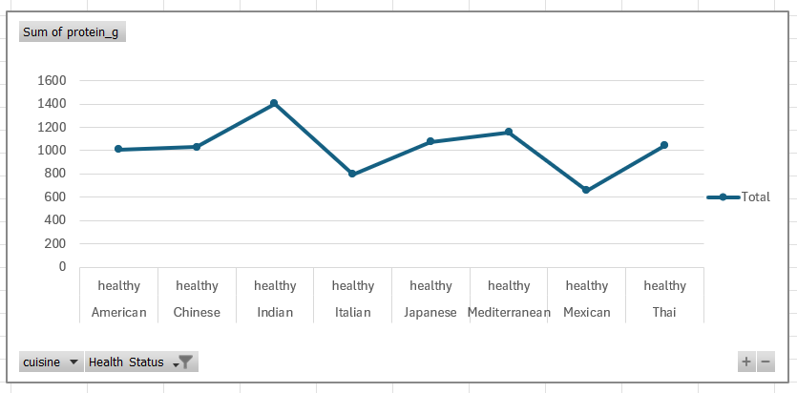
Promotion trend
Here, you can visualize the “promotion” trend as a line chart, showing how healthiness or ratings improve across cuisines and health statuses, specified as “Healthy”.
Healthy Eating Dataset

Slide 13
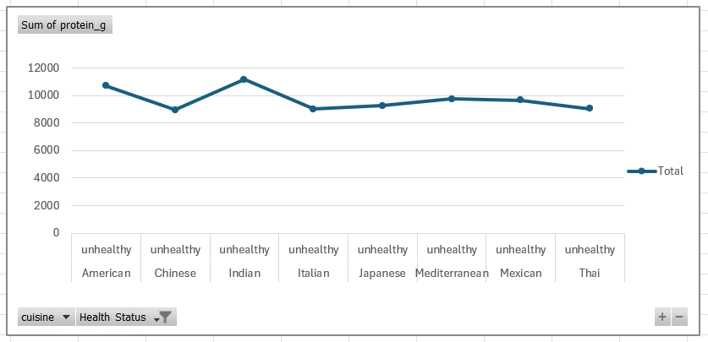
Promotion trend
Here, you can visualize the “promotion” trend as a line chart, showing how healthiness or ratings improve across cuisines and health statuses, specified as “Unhealthy”.
Healthy Eating Dataset

Slide 14
SQL Analysis :
SQL analysis questions:
List all Vegan meals under 300 calories.
Get all meals with a cooking time of more than 60 minutes.
Find all meals with sodium above 2000 mg.
Find the average fat by diet type.
Top 3 cuisines with the highest average rating.
Find the top 5 healthiest meals (based on calories).
Find the top 10 meals with the highest fiber.
Find meals that have above-average protein.
Find meals with a rating higher than the average rating of Vegan meals.
Healthy Eating Dataset

Slide 15
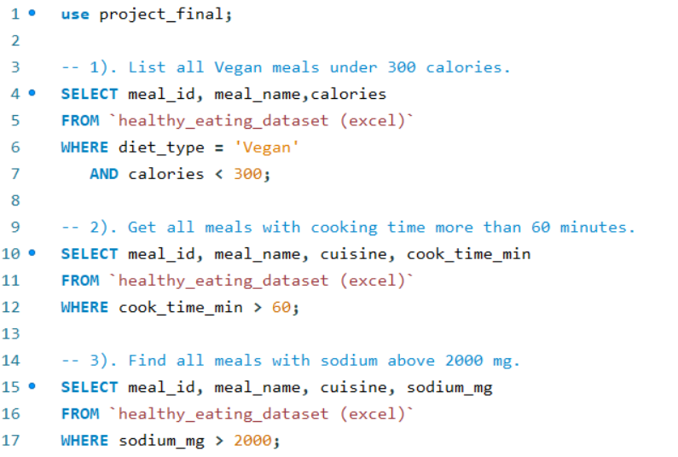
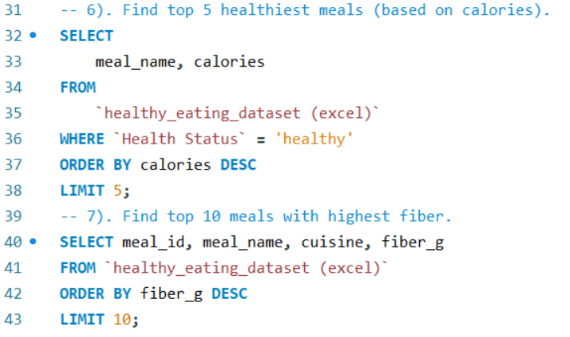
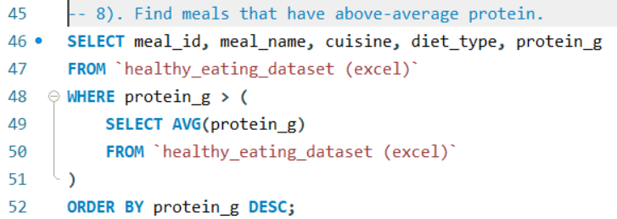
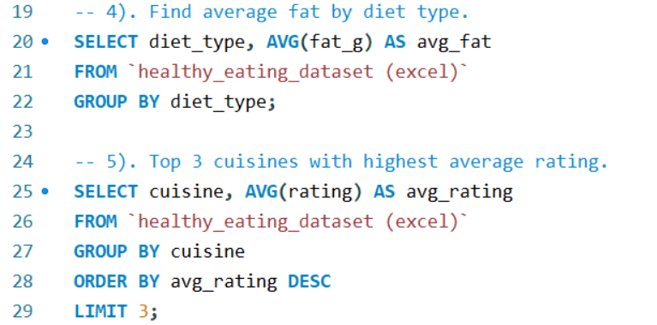
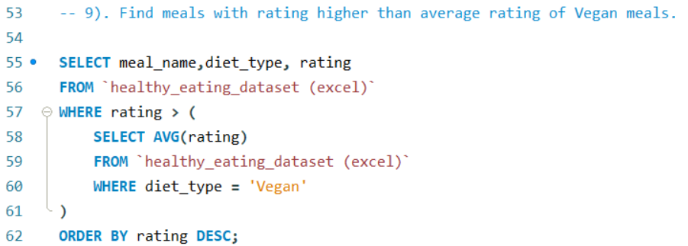
Healthy Eating Dataset

Slide 16
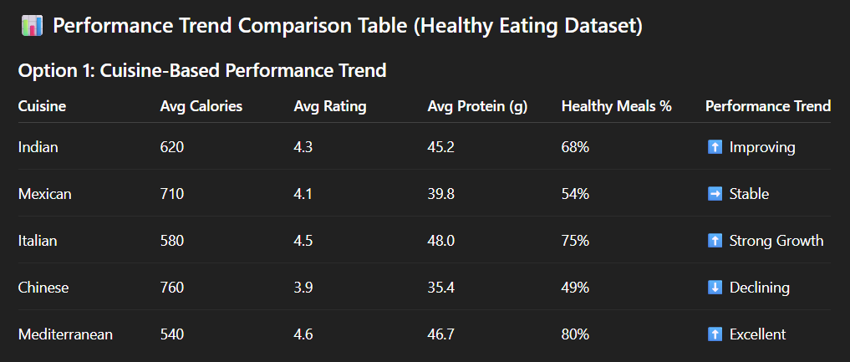
Chinese food performs poorly in terms of calorie control and health metrics, whereas Mediterranean and Italian cuisines exhibit good performance trends, driven by high ratings and nutritious meal ratios.
Healthy Eating Dataset

Slide 17
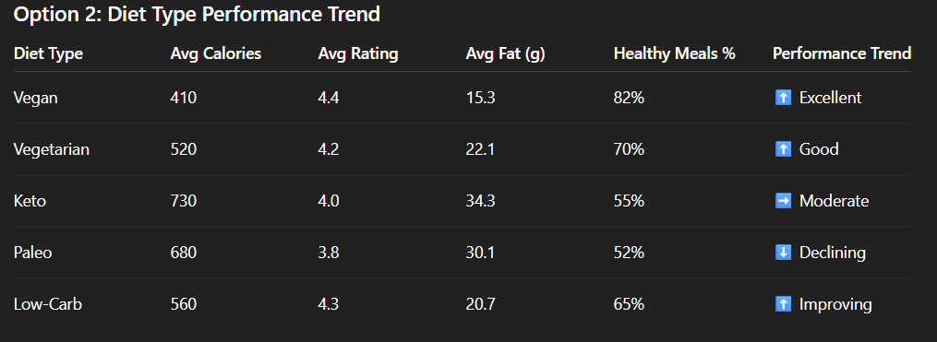
The popularity and health ratings of vegan and low-carb diets are rising, and they are performing well. Because they contain more calories and fat, Paleo and Keto are becoming less popular.
Healthy Eating Dataset

Slide 18
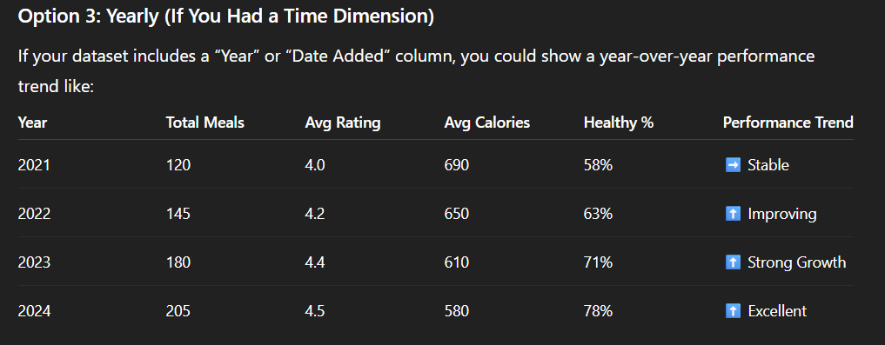
With steady rises in healthy meals and average ratings and a decline in calories, overall health performance increased from year to year.
Healthy Eating Dataset

Slide 19
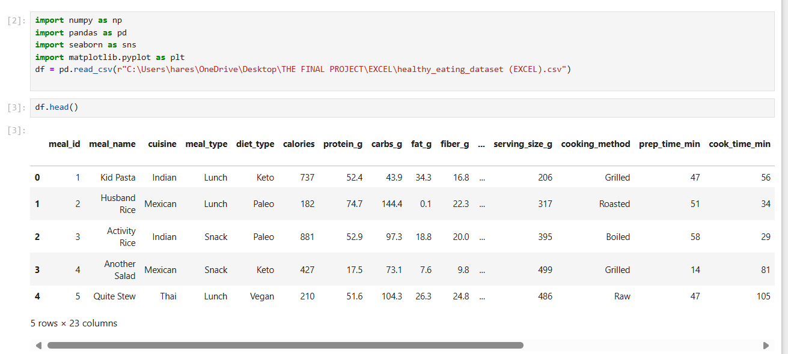
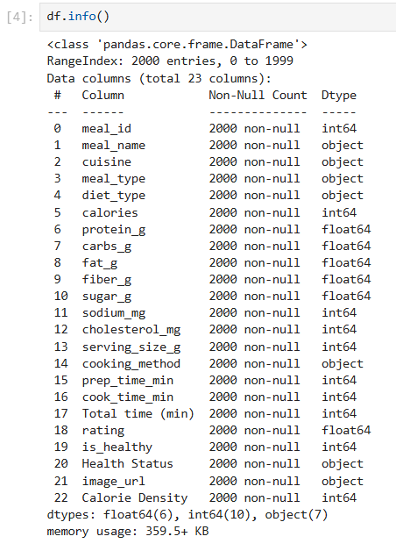
Python Analysis :
Healthy Eating Dataset

Slide 20
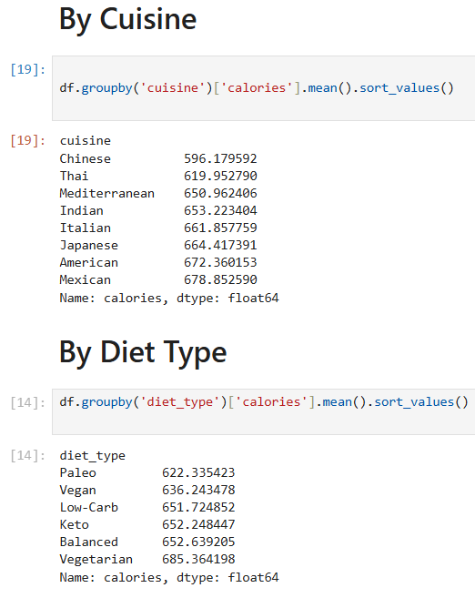
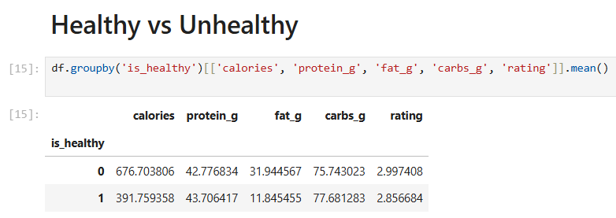
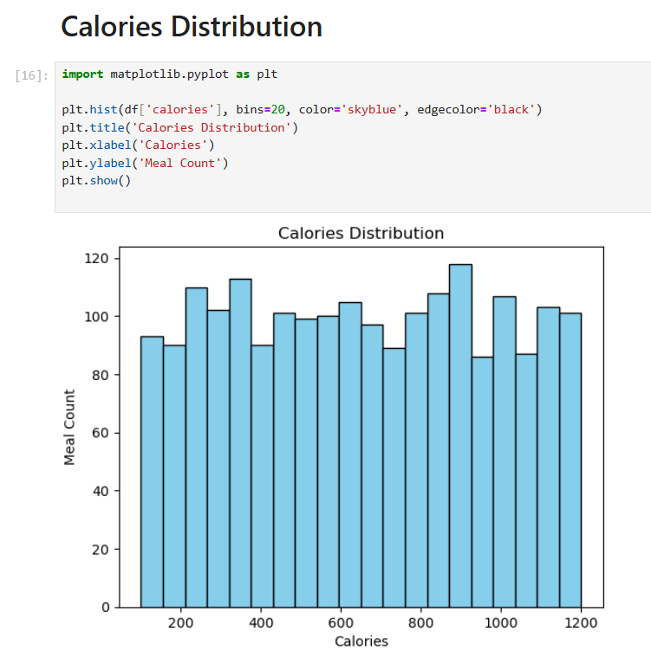
Healthy Eating Dataset

Slide 21
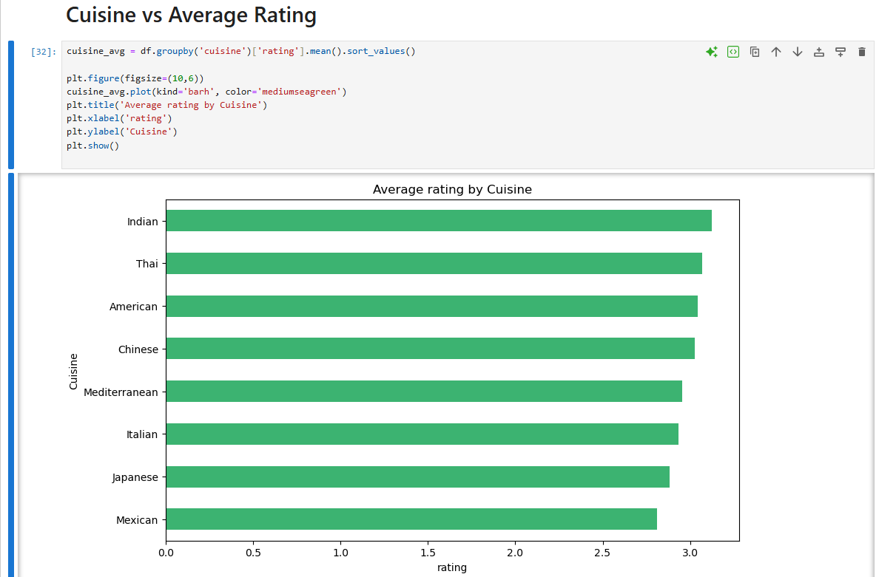
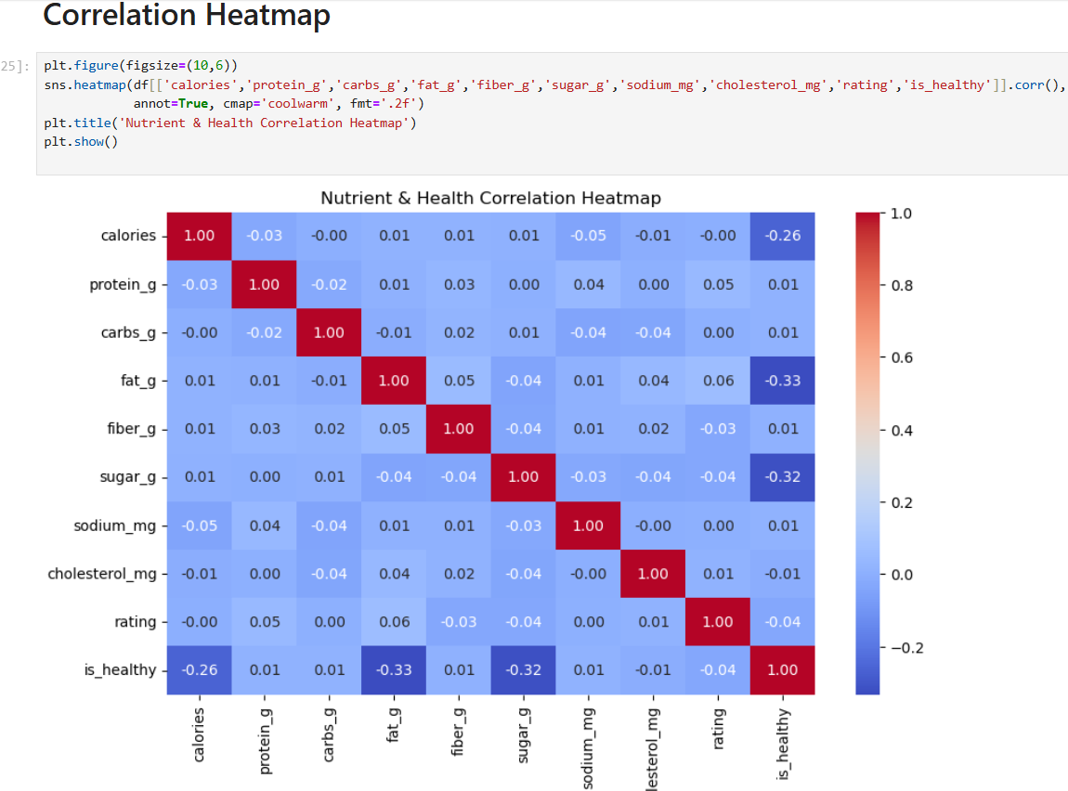
Healthy Eating Dataset

Slide 22
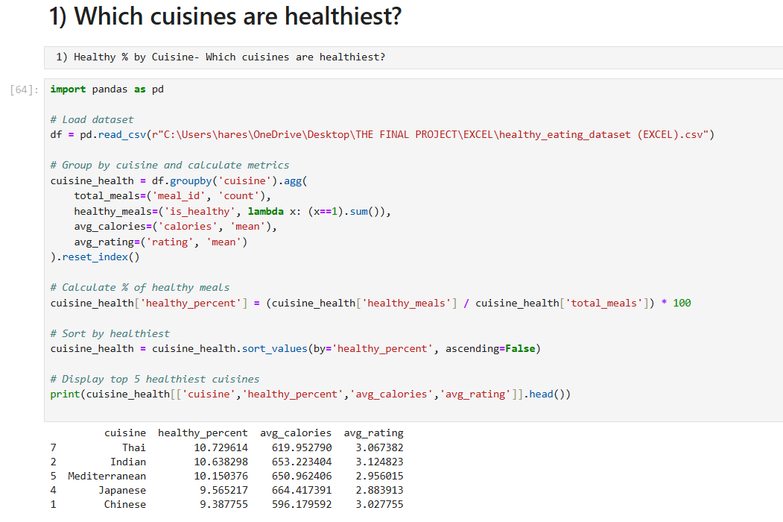
Healthy Eating Dataset

Slide 23
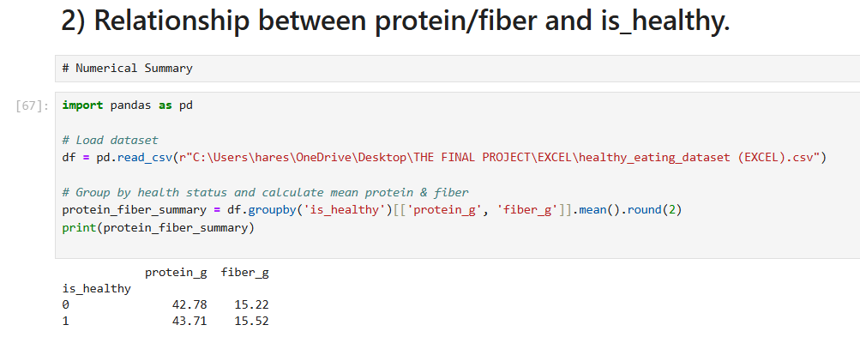
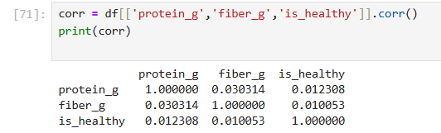
Healthy Eating Dataset

Slide 24
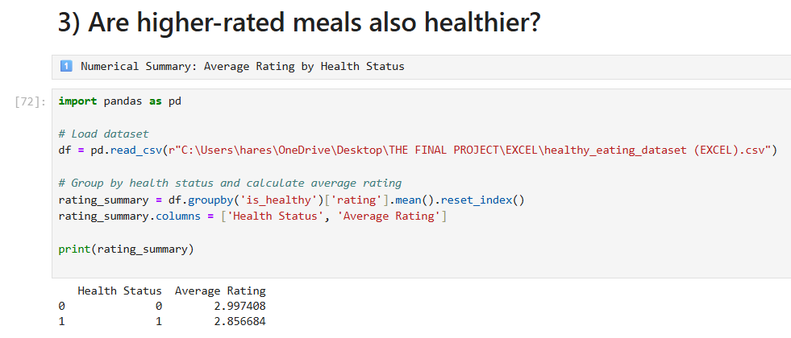
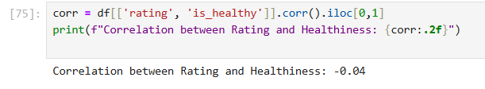
Healthy Eating Dataset

Slide 25
Power BI Dashboard Screenshots
Healthy Eating Dataset

Slide 26
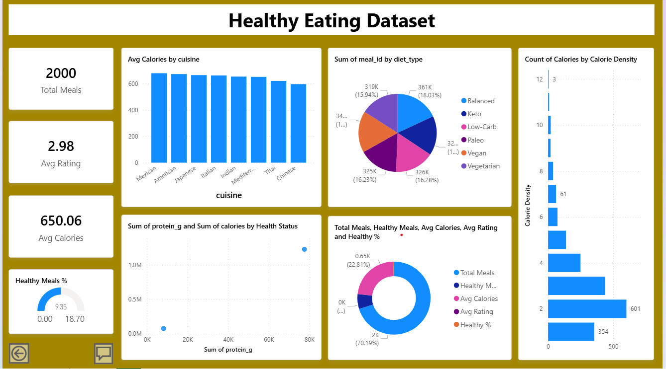
Healthy Eating Dataset

Slide 27
Summary
The Healthy Eating Dataset Project demonstrates a complete data analysis lifecycle — from raw data to insightful visualization.
By combining Excel and Power Query for cleaning, SQL for querying, Python for deep statistical analysis, and Power BI for interactive reporting, this project builds a holistic view of healthy eating patterns.
The outcome is a powerful analytical system that helps identify trends, highlight healthy meal options, and provide actionable insights into nutrition and wellness.
Healthy Eating Dataset

Slide 28
Thank you
BY
VEERARAKESH E

